Slide 1
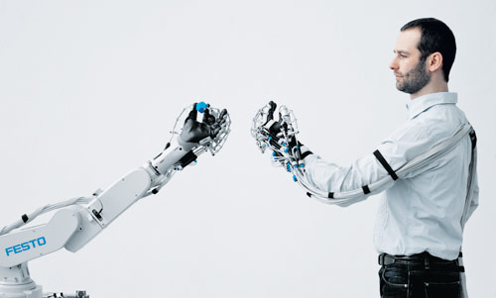
Yonova Smart Hand
Soft Robotic Hand for Hand Rehabilitation الروبوتات الذكية المتخصصة في أعادة التأهيل
This Photo by Unknown author is licensed under CC BY-SA-NC.

Slide 2
Yonova Smart Hand Introduction
Problem :
Stroke, or often referred as cerebrovascular accident (CVA), is a medical condition where there is a rapid loss of brain function due to the poor blood flow to the brain.1 The incidence of stroke remains the leading cause of mortality and long-term disability worldwide, and the occurrence has been progressively increasing over the years.2 In the United States, around 795,000 people suffer a stroke each year.34
By the year of 2050 in the United States, it is even forecasted that the number of stroke events will expand to a total of 1,334,000 cases each year.
https://wyss.harvard.edu/news/soft-robotic-glove-puts-control-in-the-grasp-of-hand-impaired-patients/

Slide 3
Our solutions
Soft robotic hands are proposed for stroke rehabilitation in terms of their high compliance and low inherent stiffness. We investigated the clinical efficacy of a soft robotic hand that could actively flex and extend the fingers in chronic stroke subjects with different levels of spasticity.

Slide 4
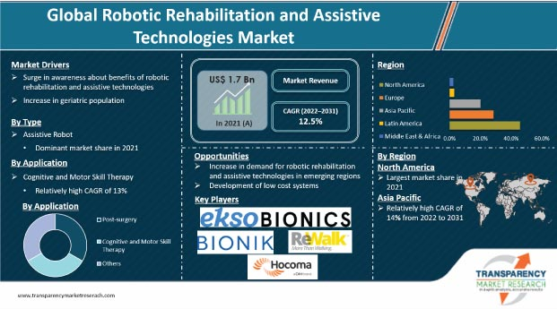
https://www.transparencymarketresearch.com/robotic-rehabilitation-assistive-technologies-market.html

Slide 5
Development plan
Technical level
Add EMG Sensor for gloves to be more effective
Redesign gloves to be more easy for wearing
Create mobile application to following up patient and publish weekly reports for doctors and users about progress and alarm
Business level
Conducting awareness campaigns for rehabilitation clinics and doctors
Make free clinical trials to create success stories with clinics and patients
Communicate with international companies to obtain exclusive sales and development agencies for rehabilitation devices

Slide 6

Team work
Project Owner: Abdallah Assem
Market Research : DINA GAD
Technical Support: Abdelrahman weal
Medical Support : Somaia and Abdulrahman
Contact:
Abdallah Assem +966593651795
+201278456932
Abdoassem26@gmail.com

